Slide 1

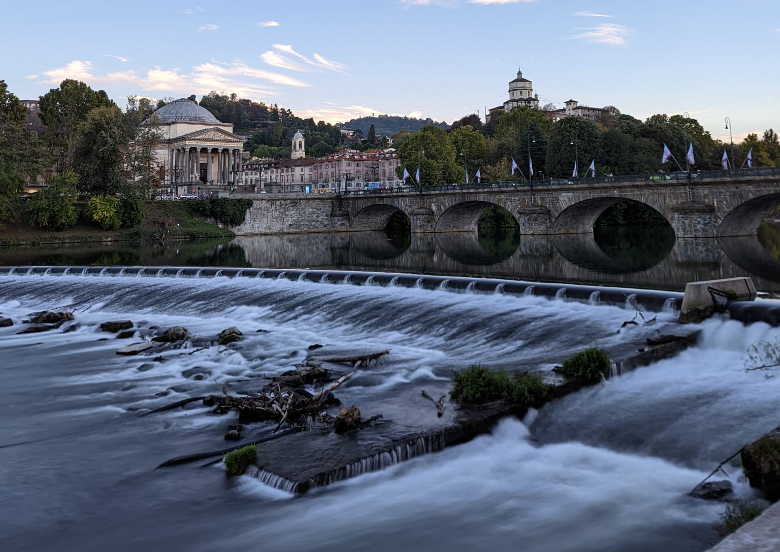
"Hydrologic connectivity as a framework for understanding
biogeochemical flux through watersheds and along fluvial networks"
Global change ecology and fluvial ecosystem
A.Y. 2024/2025
Group 1
Arianna Bertolo, Margaux Magali Cochard, Luca Raviglione

Slide 2
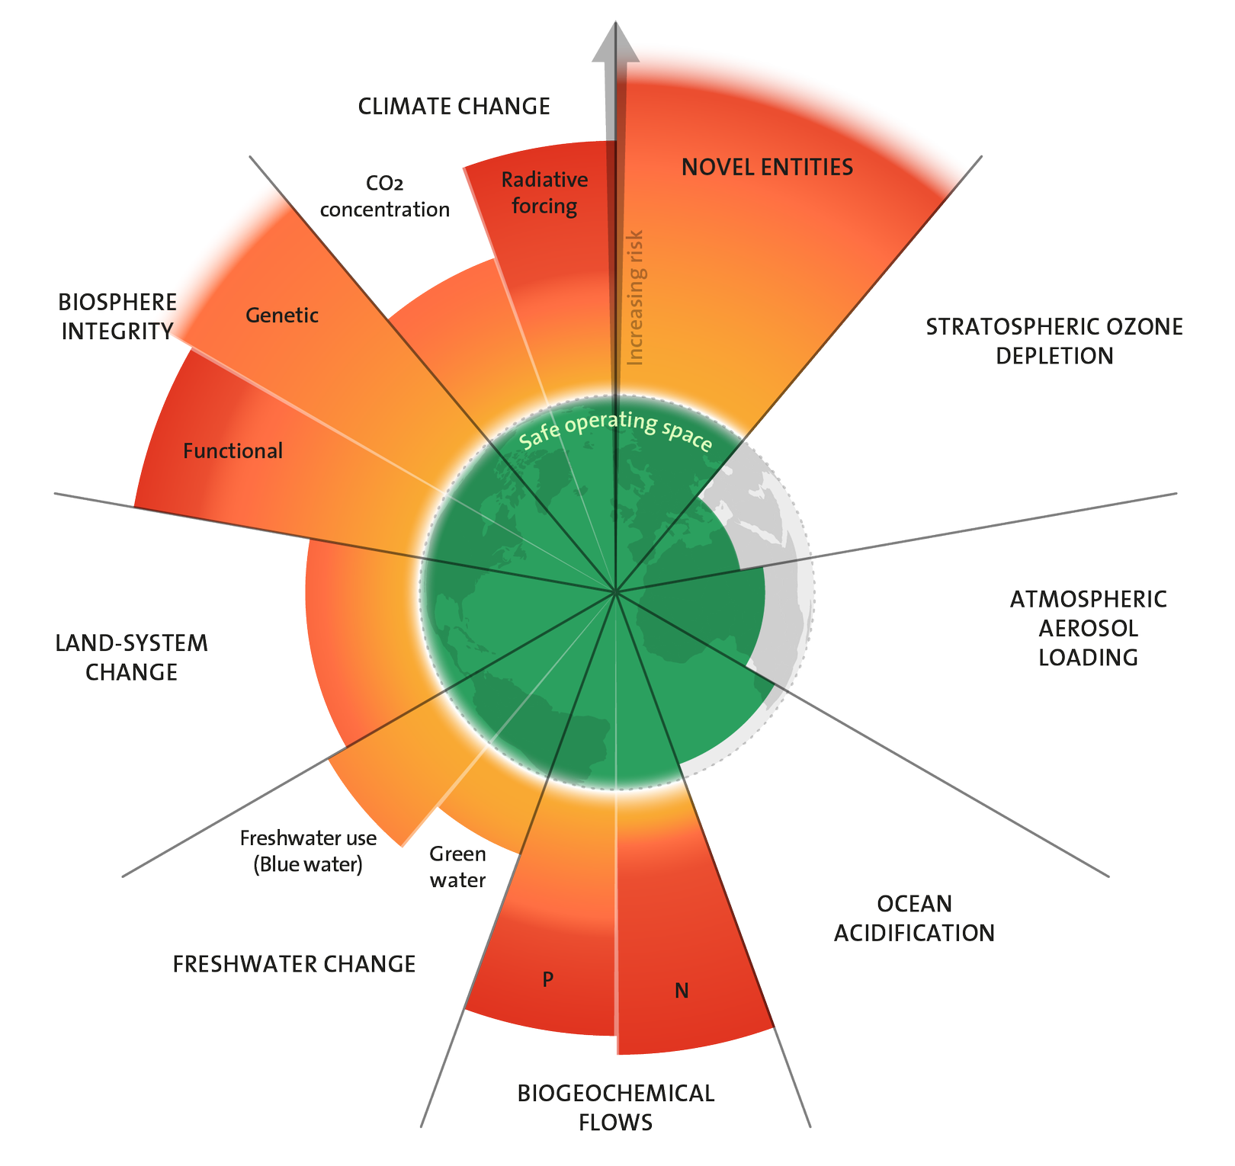


Hydrologic connectivity
as link between hillslopes to channel networks, streams to lakes, subsurface to surface, land to atmosphere, terrestrial to aquatic, and upstream to downstream
involving different spatial and temporal scales
Key points:
Forms of hydrologic connectivity and their influence on biogeochemical fluxes
Interaction across different spatial and temporal scales
Planetary boundaries of Stockholm Resilience Centre (updated to 2023)
Notes:
The first type of hydrological connectivity is is the stream-hillslope.
The Stream-hillslope connectivity is the link between terrestrial and aquatic ecosystems, where water, sediment, and nutrients are transported from hillslopes to streams.
It is unidirectional and variable to different conditions.
These connections are crucial for understanding how watersheds transport organic and inorganic materials.
It sets the initial biogeochemical template or spatiotemporal patterns of channel network nutrient loading and concentration.
The connectivity can thus be lateral, longitudinal or vertical in the channel after stream-hillslope.

Slide 3
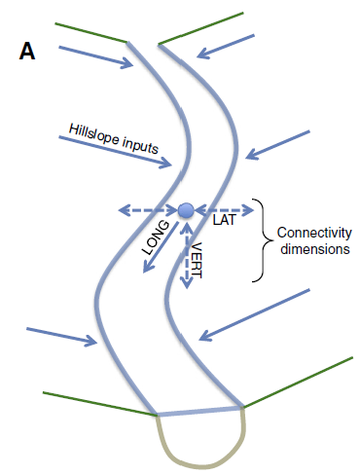
Stream-Hillslope connectivity
Unidirectional
Mainly large events
Overland flow
Considerably delivery of water, sediment, organic matter, and nutrients directly to stream channels.
Substantial water and solute delivery, but little sediments
Subsurface flow
Responsible for most of the DOC and NO3 in streams
Notes:
The first type of hydrological connectivity is is the stream-hillslope.
The Stream-hillslope connectivity is the link between terrestrial and aquatic ecosystems, where water, sediment, and nutrients are transported from hillslopes to streams.
It is unidirectional and variable to different conditions.
These connections are crucial for understanding how watersheds transport organic and inorganic materials.
It sets the initial biogeochemical template or spatiotemporal patterns of channel network nutrient loading and concentration.
The connectivity can thus be lateral, longitudinal or vertical in the channel after stream-hillslope.

Slide 4
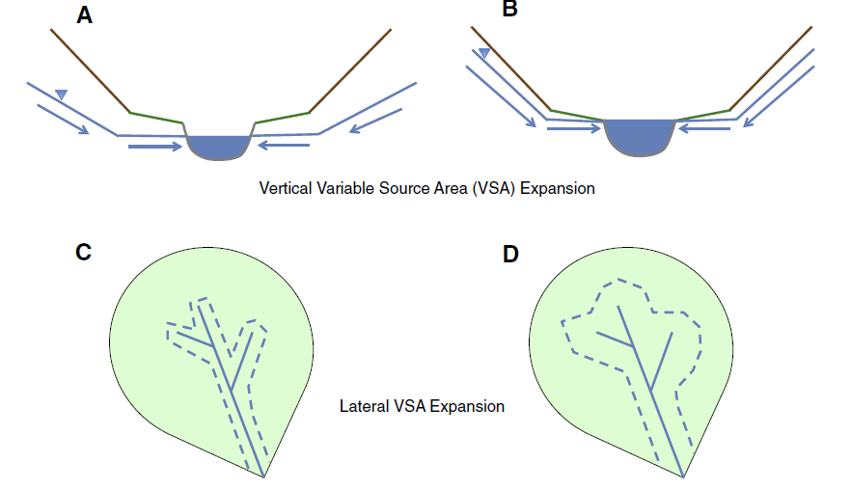
1. Stream-Hillslope connectivity: rainy/snowmelt events
Hydrological connectivity changes during precipitation. Source area expands, bringing water from areas rich in nutrients. PO4 and NO3 export dynamics.
Old water: stored in GW or soil
Larger contribution of old water to the stream
Strength and variability of this connection dictated by morphology and landscape characteristics
Streamflow mixture of
New water: precipitation
Notes:
It is important now to do some considerations about this connectivity during large events
In fact most precipitation inputs travel through and/or over the land surface before (if ever) reaching the channel network. That's why most of the water is old water

Slide 5
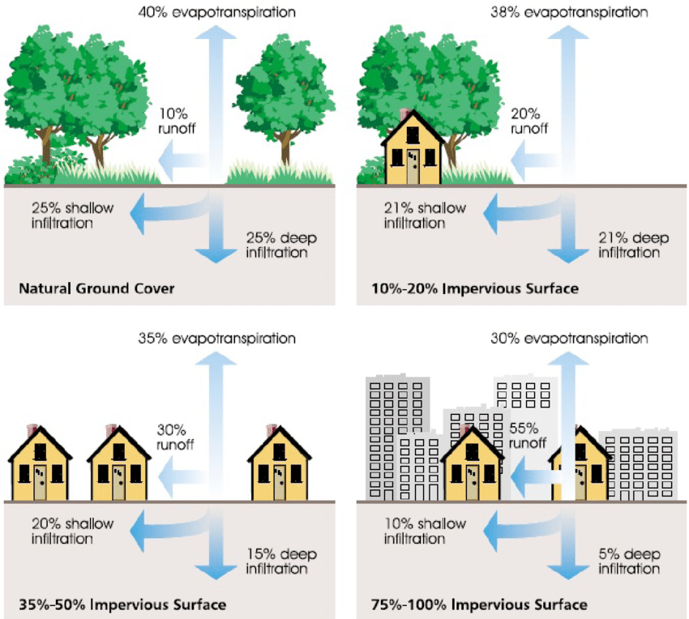
1. Stream-Hillslope connectivity: human impact
Need for different methods to assess smaller and larger watershed and rivers.
Crucial to understand human impact on the hillslope connectivity.
Human landscape alteration led to increased lateral stream-hillslope connectivity
Increased delivery of water and human pollution
Notes:
To conclude, humans can have a huge impact on the
Irrigation networks, impervious urban surfaces

Slide 6
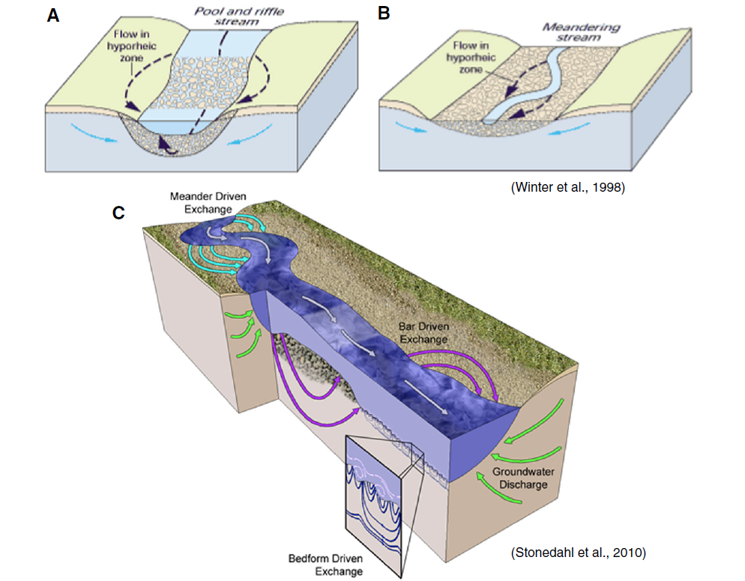
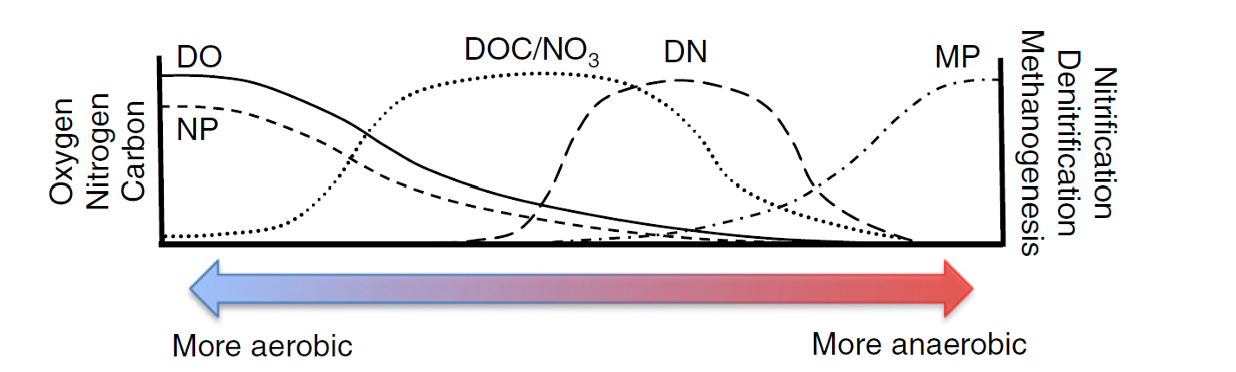
2. Stream-Groundwater connectivity
Bidirectional
Crucial for: nutrient and carbon cycle, aquifer recharge, ecosystem, streamflow dynamics
Hyporheic exchanges
Oxygen-rich water, promotion of aerobic processes
Smaller-scale exchanges (meters and minutes)
Downwelling
Depending on pressure and head gradients
Upwelling
Stream-GW Exchange
Nutrient-rich GW mixes with the oxygenated water, leading to anaerobic processes
Larger-scale exchanges (hundreds of meter and years)
Notes:
The second type of hydrological connectivity is the stream-groundwater.
It attenuates downstream fluxes and increases watershed nutrient retention.
It is crucial for...
The hyporheic zone is where surface water mixes with shallow groundwater in the porous sediments around streams. This zone is important for nutrient retention and transformation, particularly for carbon, nitrogen, and phosphorus.
· Hyporheic exchanges occur at small scales (meters and minutes) and allow for biogeochemical processes like denitrification (in areas of upwelling groundwater) and nitrification (in areas of downwelling, oxygen-rich surface water). These exchanges create biogeochemical hotspots where nutrients are processed efficiently
Within the stream-GW connectivity, there are two...
Depending on... the flow can be either downwelling or upwelling. Indeed, the stream-GW connectivity is a bidirectional connectivity.
The downwelling brings oxygen....
As you can see in the image on the right, the quantity of oxygen has a huge impact on the speciation of different substances.
r across numerous dimensions and spatiotemporal scales.

Slide 7
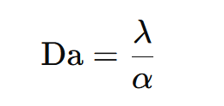
2. Stream-Groundwater connectivity: assessment
Dahmkohler number
Reaction rate
Low Da means poor connectivity. Nutrients are consumed too quickly, supply-limited.
High Da means high connectivity. Nutrients are transportend too quickly, reaction-limited.
Mass-transfer rate between the channel and the transient zone
Notes:
The question is: How can someone assess this connectivity?
In this sense, it is paramount the Dahmkohler number, described by the ratio between.....
Low Da
In fact, long residence times in transient storage zones actually necessitate a level of hydrologic disconnection from main channel flow (τ=1/α; where τ is residence time),
Researchers use techniques like tracer injections, geophysical imaging, and temperature monitoring to trace water flow between streams and groundwater.

Slide 8
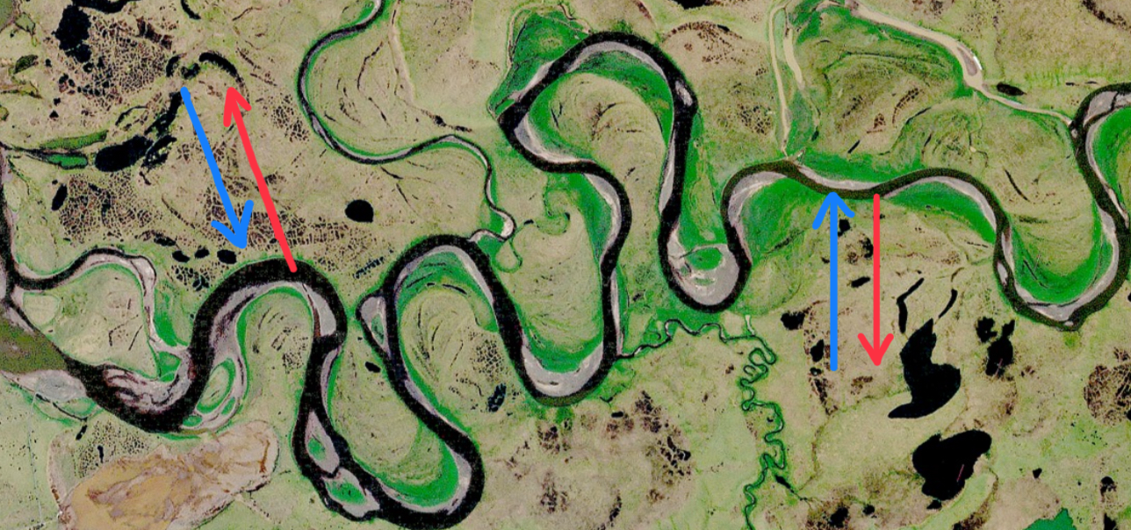
3. River-floodplain connectivity
overbank flow
Reverse connection flow
Overland flow
water, sediment, organic material, and nutrients flows between river, floodplains, and riparian wetlands
Dynamic network of dead arms (semi-lotic) and ponds (lentic)
Fertilization of the floodplain
Subsurface pathways
Notes:
The question is: How can someone assess this connectivity?
In this sense, it is paramount the Dahmkohler number, described by the ratio between.....
Low Da
In fact, long residence times in transient storage zones actually necessitate a level of hydrologic disconnection from main channel flow (τ=1/α; where τ is residence time),
Researchers use techniques like tracer injections, geophysical imaging, and temperature monitoring to trace water flow between streams and groundwater.

Slide 9
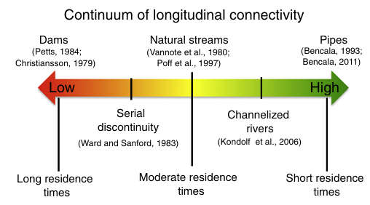
4. Longitudinal connectivity
Advection + transient storage + long-lasting retention
Notes:
The question is: How can someone assess this connectivity?
In this sense, it is paramount the Dahmkohler number, described by the ratio between.....
Low Da
In fact, long residence times in transient storage zones actually necessitate a level of hydrologic disconnection from main channel flow (τ=1/α; where τ is residence time),
Researchers use techniques like tracer injections, geophysical imaging, and temperature monitoring to trace water flow between streams and groundwater.

Slide 10
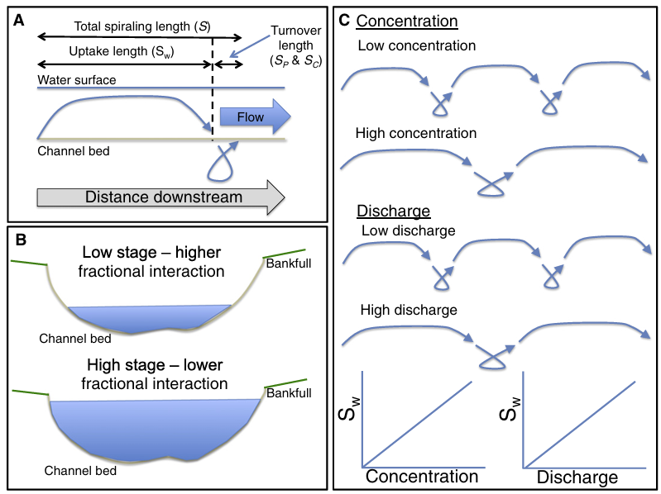
4. Longitudinal connectivity
Nutrient spiraling theory
the system becomes leaky with respect to Nitrogen
Notes:
The question is: How can someone assess this connectivity?
In this sense, it is paramount the Dahmkohler number, described by the ratio between.....
Low Da
In fact, long residence times in transient storage zones actually necessitate a level of hydrologic disconnection from main channel flow (τ=1/α; where τ is residence time),
Researchers use techniques like tracer injections, geophysical imaging, and temperature monitoring to trace water flow between streams and groundwater.

Slide 11
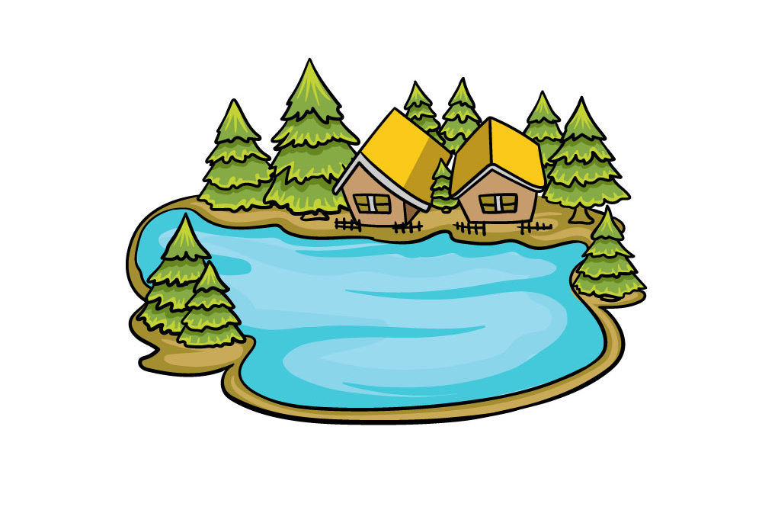
5. Stream-lake connectivity
Nutrient and organic transfer:
Velocities are lower
Residence time are increasing
Particulate material settling is greater (sediment)
Biochemical hot-spots
Enhance retention of N, total P (TP), total suspended sediments (TSS).
Decrease annual variability of TSS, TP and DOC export
Notes:
The question is: How can someone assess this connectivity?
In this sense, it is paramount the Dahmkohler number, described by the ratio between.....
Low Da
In fact, long residence times in transient storage zones actually necessitate a level of hydrologic disconnection from main channel flow (τ=1/α; where τ is residence time),
Researchers use techniques like tracer injections, geophysical imaging, and temperature monitoring to trace water flow between streams and groundwater.

Slide 12


Interactions across dimensions and scales of connectivity
Water from hillslope regions as link between terrestrial and aquatic environment
Sets the initial nutrient loading and concentration
Longitudinal connection
River-floodplain connectivity
Influence biodiversity, groundwater recharge and nutrient processing​
Smaller scale
Influence biogeochemical processes and nutrient retention
Provide habitat
Hyporheic zone as interactions between streams and shallow subsurface flow
Stream-hillslope prevalent during wet periods
Hyporheic, stream-GW, and river-floodplain prevalent during dry periods
Notes:
The question is: How can someone assess this connectivity?
In this sense, it is paramount the Dahmkohler number, described by the ratio between.....
Low Da
In fact, long residence times in transient storage zones actually necessitate a level of hydrologic disconnection from main channel flow (τ=1/α; where τ is residence time),
Researchers use techniques like tracer injections, geophysical imaging, and temperature monitoring to trace water flow between streams and groundwater.

Slide 13
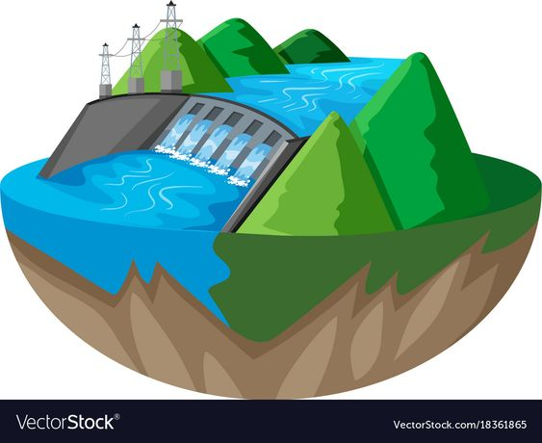

Interactions across dimensions and scales of connectivity
Human activities impact on lateral and longitudinal connections
Lateral connection
Longitudinal connection
Urbanization
Levees
Channelization
Dams
Alteration of hydrologic connections
Necessity for the restoration of aquatic ecosystems
Notes:
The question is: How can someone assess this connectivity?
In this sense, it is paramount the Dahmkohler number, described by the ratio between.....
Low Da
In fact, long residence times in transient storage zones actually necessitate a level of hydrologic disconnection from main channel flow (τ=1/α; where τ is residence time),
Researchers use techniques like tracer injections, geophysical imaging, and temperature monitoring to trace water flow between streams and groundwater.

Slide 14




How can we develop an increased understanding of these processes?
 | 2 Developing new methods and numerical model appropriate for larger systems |  | 4 Integrating across dimensions, scales, and disciplines
1 Integrating data and understanding across the spatial dimensions of connectivity |  | 3 Evaluating process heterogeneity and feedbacks across temporal scales
Notes:
The question is: How can someone assess this connectivity?
In this sense, it is paramount the Dahmkohler number, described by the ratio between.....
Low Da
In fact, long residence times in transient storage zones actually necessitate a level of hydrologic disconnection from main channel flow (τ=1/α; where τ is residence time),
Researchers use techniques like tracer injections, geophysical imaging, and temperature monitoring to trace water flow between streams and groundwater.

Slide 15
Bibliography
Covino, T. (2016). Hydrologic connectivity as a framework for understanding biogeochemical flux through watersheds and along fluvial networks. Geomorphology, 277, 133–144. https://doi.org/10.1016/j.geomorph.2016.09.030
Rezaei, A. R., Ismail, Z. B., Niksokhan, M. H., Ramli, A. H., Sidek, L. M., & Dayarian, M. A. (2019). Investigating the effective factors influencing surface runoff generation in urban catchments–A review. Desalination Water Treat, 164, 276-292.
Planetary boundaries: Guiding human development on a changing planet
(Steffen et al., 2015)
https://www.science.org/doi/full/10.1126/science.1259855

